Slide 1
TRAFFIC ENGINEERING
UNIT-III

Slide 2
Traffic Engineering
Traffic engineering analysis enables one
to determine the ability of a telecommunication network to carry a given traffic at a loss probability.
Blocking probability is the major issue for design.
Not only the switching elements but also digit receivers, inter-stage links, call processors, trunk between links contribute in blocking of a call.

Slide 3
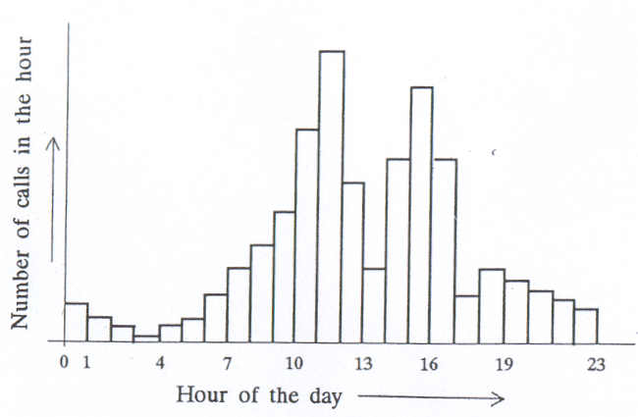
Variation of traffic on a typical working day
In a telephone network, the traffic load in a typical working day during the 24 hours is shown in the fig. below.

Slide 4
The traffic pattern is same irrespective of the area considered.
There is a little use of the network during 0 to 6 hours as most of the population is asleep.
There is a large peak in the mid-forenoon and mid afternoon signifying busy office activities.
The traffic is low during the lunch hour i.e 12 to 14 hours.
The period 17 to 18 hours is characterized by low traffic as people are moving from office to their residences.
After 18 hours the peak of domestic calls occur.

Slide 5
Network parameters
Busy hour:
In a day, the 60 minute interval during which the traffic is the highest is called the busy hour.
Maximum number of calls are generated during the busy hour.
It varies from exchange to exchange depending on locations and community interest of the subscribers.
It may show seasonal, weekly and in some places daily variation.

Slide 6
There are three types of busy hour as recommended by CCITT in its recommendation E.600 :
1. Busy hour: Continuous 1 hour period lying wholly in the time interval concerned, for which the traffic volume or the number of call attempts is greatest.
2. Peak busy hour: The busy hour each day. It usually varies from day to day, or even over a number of days.

Slide 7
3. Time consistent busy hour: The 1 hour period starting at the same time each day for which the average traffic volume or the number of call attempts is greatest over the days under consideration.
Call completion rate (CCR): Call completion rate is defined as the ratio of the number of successful calls to the number of call attempts.
Note: A call attempt is said to be successful or completed if the called party answers.

Slide 8
The CCR parameter is used in dimensioning the network.
A network is usually designed to provide an overall CCR of over 0.70.
Busy Hour Call Attempts (BHCA)‏: The number of call attempts in the busy hour is called busy hour call attempts.
BHCA is an important parameter in deciding the processing capacity of a common control or a stored program control system of an exchange.

Slide 9
Busy hour calling rate: The busy hour calling rate is defined as the average number of calls originated by a subscriber during the busy hour.
busy hour calling rate=average busy hour calls/total number of subscribers
Busy hour calling rate is useful in sizing the exchange to handle peak traffic.
P.1: An exchange serves 2000 subscribers. If the average BHCA is 10000 and the CCR is 60%, calculate the busy hour calling rate.

Slide 10
Day-to-busy hour traffic ratio: It is defined as the ratio of busy hour calling rate to the average calling rate for the day.
Traffic intensity:
For analytical treatment, all the common subsystems of a telecommunication network are collectively termed as servers.
The traffic on a network can be measured in terms of occupancy of the servers in the network.

Slide 11
The traffic intensity is defined as the ratio of the period for which a server is occupied to the total period of observation.
A0=(Period for which server is occupied)/(total period of observation)
Generally, the period of observation is taken as 1 hour.
A0 is dimensionless and is called erlang (E).
A server is said to have 1 erlang of traffic if it is occupied for the entire period of observation.

Slide 12
P.2: In a group of 10 servers, each is occupied for 30 minutes in an interval of two hours. Calculate the traffic carried by the group.
P.3: A group of 20 servers carry a traffic of 10 erlangs. If the average duration of a call is 3 minutes, calculate the number of calls put through a single server and the group as a whole in one hour period.

Slide 13
Traffic intensity can be measured in another way. This measure is known as centum call second (CCS) which represents call-time product.
One CCS may mean one call for 100 seconds duration or 100 calls for one second duration each or any other combination.
CCS is valid only in telephone circuits (from subscribers point of view).
Erlang provides better measure for representing traffic intensity (from exchange point of view).

Slide 14
Sometimes Call seconds (CS) and Call minutes (CM) are also used to measure traffic intensity.
1E=36 CCS=3600 CS=60 CM
P.3: A subscriber makes three phone calls of 3 minutes, 4 minutes and 2 minutes duration in a one-hour period. Calculate the subscriber traffic in erlangs, CCS and CM.
P.4: Over a 20 minute observation interval, 40 subscribers initiate calls. Total duration of the calls is 4800 seconds. Calculate the load offered to the network by the subscriber and the average subscriber traffic.

Slide 15
There are two more parameters that are required to estimate the traffic intensity or the network load and these are:
Average call arrival rate, C (in number of calls per minute)
Average holding time per call, th (minutes per call)
The load offered to the network in terms of the above parameters can be expressed as,
A=Cth

Slide 16
Notes:
The traffic is being handled in two ways:
i. Based on the traffic generated by the subscriber
ii. Based on the observation of busy servers in the network.

Slide 17
Handling of overload traffic
There are two ways of handling overload traffic.
loss systems and delay systems are introduced depending on these two ways of handling traffic.

Slide 18
loss systems:
In loss system, the overload traffic may be rejected without being serviced.
calls are lost.
Automatic telephone exchanges behave like loss systems.
Circuit switched networks are loss systems.
Performance parameters are grade of service and blocking probability.
Traffic models used to study loss systems are known as blocking or congestion models.

Slide 19
Delay system:
In delay systems, the overload traffic is held on a queue until network facilities become available.
Calls are delayed.
Operator-oriented manual exchanges are delay systems.
Store-forward message or packet switched networks are delay systems.
Performance parameter is service delays.
Traffic models used to study delay systems are known as queuing models.

Slide 20
Grade of service (GOS)
In loss systems, the traffic carried by the network is generally lower than the actual traffic offered to the network by the subscribers.
The overload traffic is rejected.
The amount of traffic rejected by the network is an index of quality of service by the network.
This termed as grade of service (GOS).

Slide 21
The GOS is defined as the ratio of lost traffic to the offered traffic.
Offered traffic is the product of average number of calls (A) generated by the users and the average holding time per call (th).
The actual traffic carried by the network is called the carried traffic.
Accordingly GOS is given by, GOS=(A-A0)/A
where, A=offered traffic
A0=carried traffic
A-A0=lost traffic

Slide 22
Smaller the value of GOS, better is the service.
The recommended value of GOS in India is 0.002.
GOS 0.002 means that two calls in 1000 calls or one call in 500 calls may be lost.

Slide 23
Differences between Blocking probability and GOS
It may appear that blocking probability (PB) is same as GOS but they are not same.
PB is defined as the probability that all the servers in a system are busy. Whereas, GOS is defined as the fraction of calls lost.
PB is arrived at by observing the busy servers, whereas, GOS is arrived at by observing the number of rejected subscriber calls in a switching system.

Slide 24
In a system with equal number of servers and subscribers, GOS is zero but there is a definite probability that all the servers are busy at a given instant and hence PB is not zero.
GOS is measure from subscriber point of view whereas, PB is a measure from the network point of view.
GOS is called call congestion or loss probability and PB is called time congestion.

Slide 25
Why GOS is zero for delay systems
In case of delay systems, the traffic carried by the network is same as the load offered to the network by the subscriber.
Since the overload traffic is queued, all calls are put through network as and when network facilities are available.
So, GOS is not meaningful in the case of delay systems and is zero always.
The probability that a call experiences a delay, is called delay probability.

Slide 26
Modelling Switching Systems
A telecommunication network carries traffic generated by a large number of individual subscribers connected to the networks.
Subscriber generate calls in a random manner.
The call generation and therefore the behavior of the network or the switching network in it can be described as a random process.

Slide 27
A random process or a stochastic process is one in which one or more quantities vary with time in such a way that the instantaneous values of the quantities are not determined precisely but are predictable with certain probability.
These quantities are called random variables.
Types of stochastic processes:
Continuous time continuous state
Continuous time discrete state
Discrete time continuous time
Discrete time discrete state

Slide 28
Random processes whose statistical parameters do not change with time are known as stationary processes.
The random processes which have identical time and ensemble averages are known as ergodic processes.
In some random processes, the mean and variance are stationary and the higher order moments may vary with time, such processes are known as wide-sense-stationary processes.

Slide 29
Markov processes
Markov process is an important class of random processes that have some special properties.
The properties were defined by A.A Markov in1907.
This class of processes is of great interest to the modelling of switching systems.
A discrete time Markov chain or discrete time discrete state Markov process is defined as one which has the following property:

Slide 30
Where, t1<t2….<tn<tn+1 and xi is the i-th discrete space variable.
The equation states that the random variable X takes on the value xn+1 at time step n+1 is entirely determined by its state value in the previous step n and is independent of its state values in earlier time steps; n-1,n-2,n-3 the etc.
The entire past history of the process is summerised in its current state and hence next state is determined only by current state.

Slide 31
P.4: During a 2 hour busy period, 2400 calls arrive at an exchange. Average holding time per call is two minutes. What is the traffic load in (a) erlangs, (b) CCS
P.5: A call processor in an exchange require 120 ms to service a complete call. What is the BHCA rating for the processor, if the exchange is capable of carrying 700 erlang of traffic? What is the call completion rate? Assume average call holding time of two minutes.

Slide 32
P.6: In an exchange, the calls arrive at the rate of 1100 calls per hour, with each call holding for a duration of three minutes. If the demand is serviced by a trunk group of 50 lines, determine GOS.
P.7: An exchange designed to handle 2000 calls during the busy hour. One day the number of calls during the busy hour is 2200. What is the resulting GOS?

Slide 33
P.8: The traffic statistics of a company using a PABX indicates that 180 outgoing calls are initiated every hour during working hours. Equal number of calls come. Each call lasts for 200 seconds on the average if the GOS required is 0.05, determine the number of lines required between the PABX and the main exchange.

Slide 34
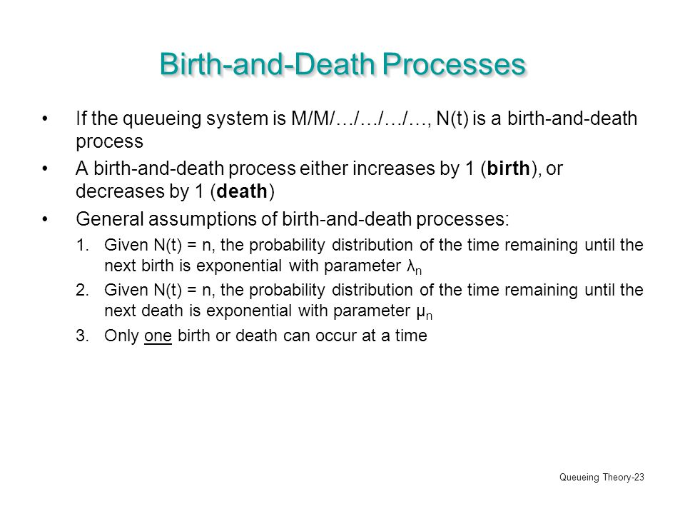
Birth-death process

Slide 35
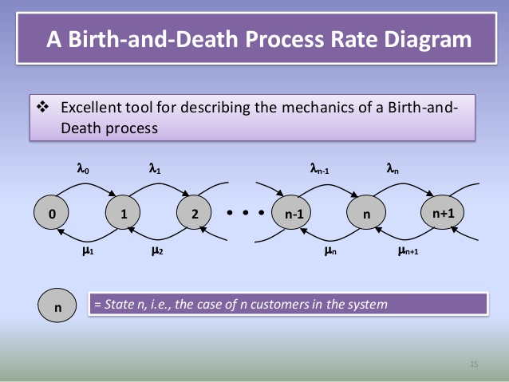

Slide 36
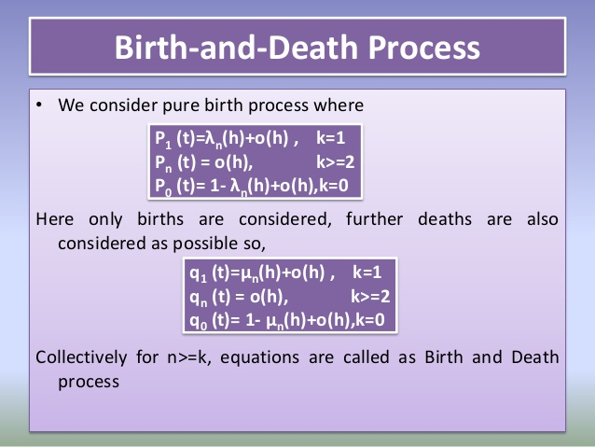

Slide 37
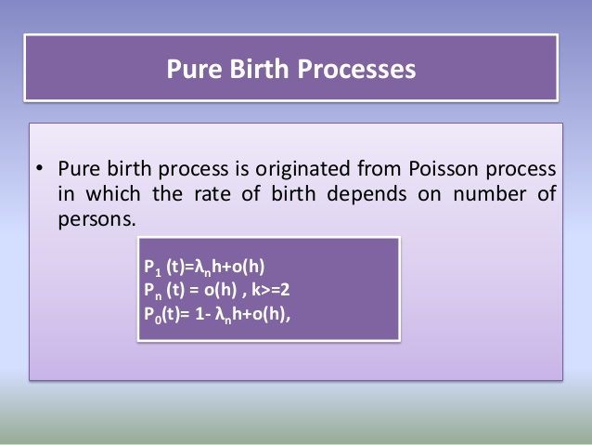

Slide 38
Three aspects while dealing with the
analysis of telecommunication systems:
Modelling the system
Traffic arrival model
Service time distribution
Three models of loss systems
Lost calls cleared (LCC)‏
Lost calls returned (LCR)‏
Lost calls held (LCH)‏

Slide 39
Lost Calls Cleared System with Infinite
Resources
Lost Calls Cleared System with Finite
Subscribers
Lost Calls Returned System
Lost Calls Held System

Slide 40
 Three aspects while dealing with the analysis of the telecommunication systems:
Modelling System
Traffic Arrival Model
Service time distribution
 Overflow traffic may be handled in three ways:
o the traffic rejected by one set of resources may be cleared by another set of resources in the network.
The traffic may return to the same resource after sometime.
The traffic may be held by the resource as if being serviced but actually serviced only after the resources become available.

Slide 41
Lost calls cleared (LCC)
Lost calls returned (LCR)
Lost calls held (LCH)

Slide 42
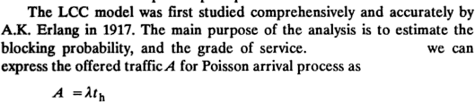
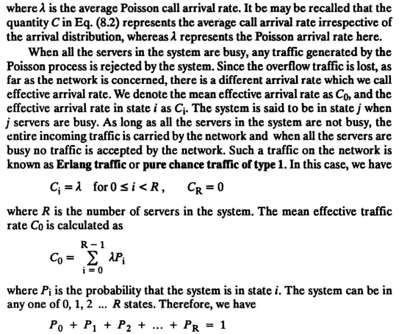

Slide 43
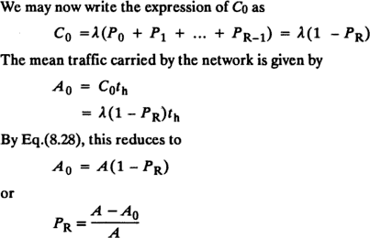
 We conclude that GOS= PB

Slide 44
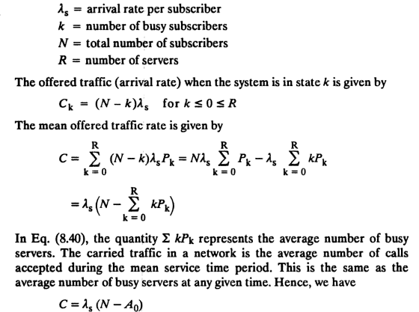

Slide 45
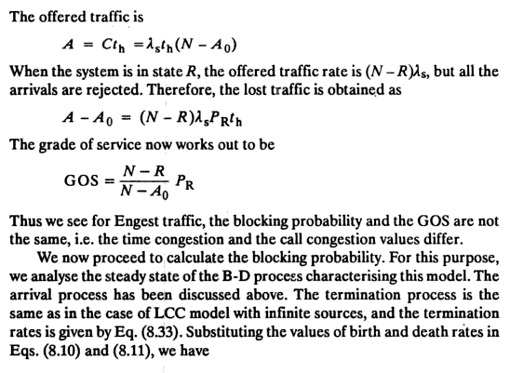

Slide 46
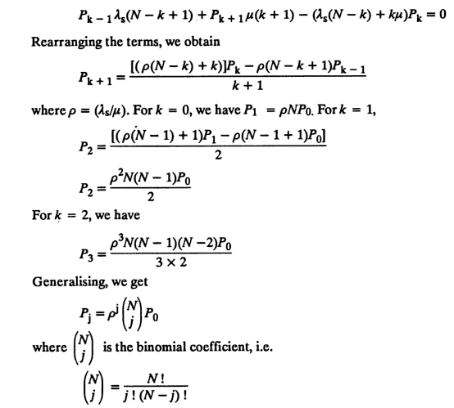

Slide 47
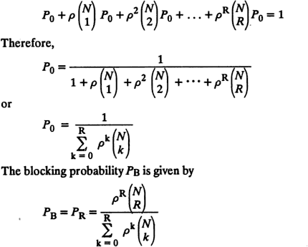

Slide 48
Offered traffic comprises of two components: Offered traffic= new traffic+ retry traffic
Taking into call the returning calls, LCR model is designed.
Following assumptions are made:
No new call is generated when a blocked call is being retried.
A number of retry attempts may be involved before a call eventually gets serviced.
Retries are attempted after a random time and each retry time is stastically independent of the others.
Typical waiting time before a retry is longer than the average holding time.

Slide 49

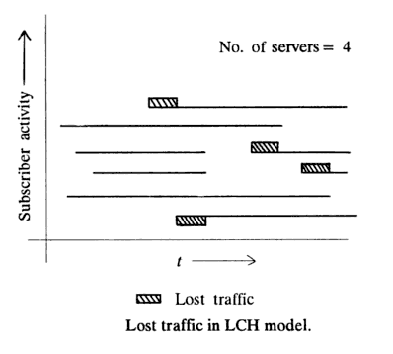

Slide 50

